Slide 1
AI Coding Spectrum & Development Tools
Reference: eclipsesource.com/blogs/2025/06/26/ai-coding-spectrum-levels-of-assistance/
Notes:
This deck introduces the 6 levels of AI coding support and maps real tools to each level.

Slide 2
The 6 Levels of AI Coding Assistance
Level 0: Static tools
Level 1: Token-level assistance
Level 2: Block-level generation
Level 3: Supervised automation
Level 4: Agentic coding support
Level 5: Autonomous coding
Notes:
Introduce the spectrum and explain how each level increases automation and risk.

Slide 3
Level 0 – Static Tools
Examples:
Google Colab without GenAI
Visual Studio Code without GenAI
Pros: Consistent formatting
Concerns: No logic understanding
Notes:
Level 0 tools ensure clean code style but offer no intelligence.

Slide 4
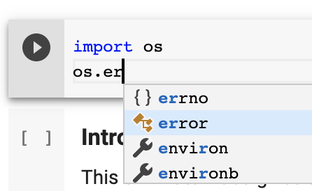
Level 1 – Token-Level Assistance
Examples:
IntelliSense
Google Colab autocomplete
Pros: Faster typing
Concerns: Limited to syntax suggestions (e.g.: parameters of a given function)
https://stackoverflow.com/questions/57502384/what-do-different-symbols-mean-in-google-colab-auto-autocomplete
Notes:
Explain that these tools do not understand intent or code structure.

Slide 5
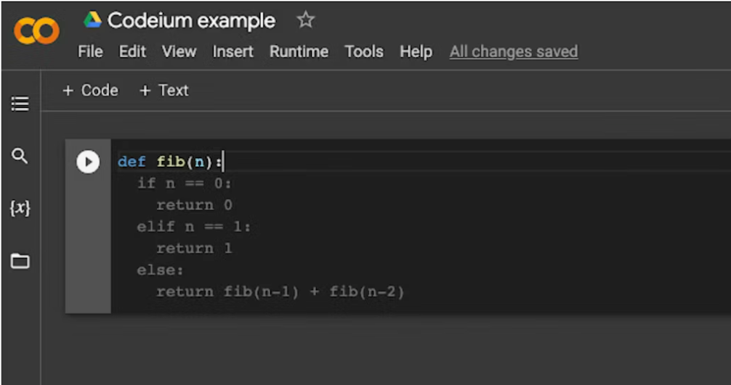
Level 2 – Block-Level Code Generation
Examples:
GitHub Copilot
Tabnine
Windsurf predictive code (extension)
Pros: Generates functions or code blocks
Concerns: Logic does not extend well beyond existing block
Notes:
Discuss responsible use and verifying AI-generated code.

Slide 6
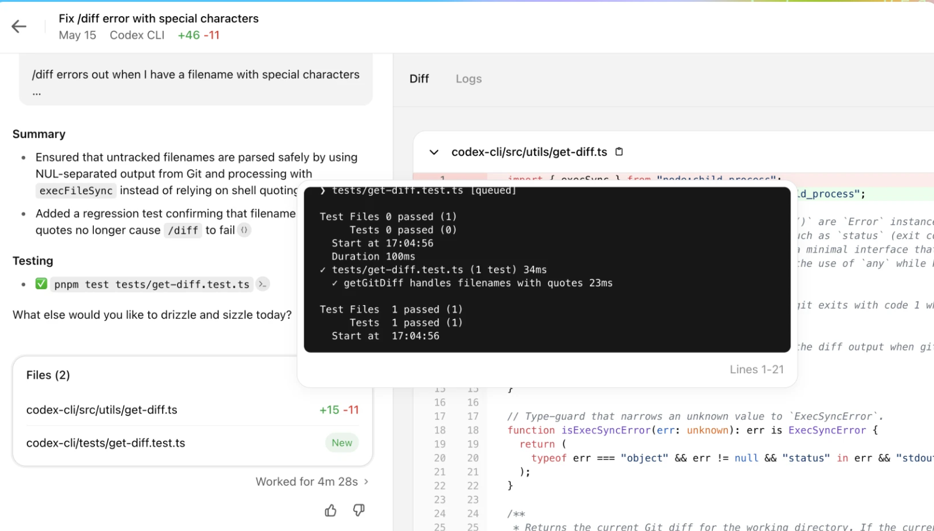
Level 3 – Supervised Automation
Examples:
ChatGPT coding mode
Gemini Advanced
Pros: Multi-step reasoning and debugging
Concerns: Must still confirm logic manually
Notes:
Explain that these tools can create, test, and refactor code with guidance.

Slide 7
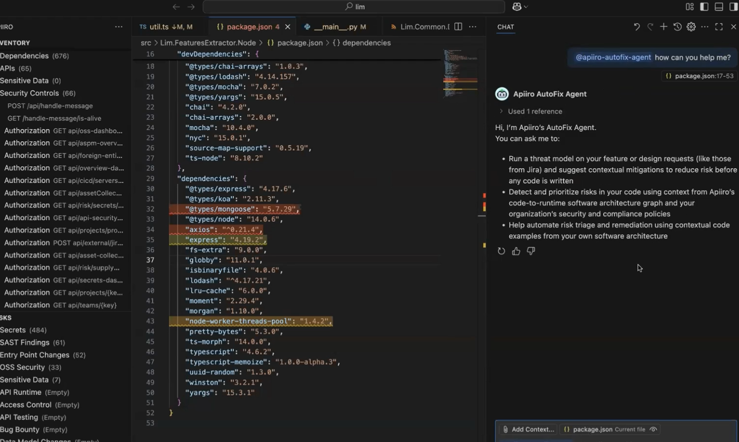
Level 4 – Agentic Coding Support
Examples:
Sourcegraph Amp
Apiiro
Pros: Multi-file changes and planning
Concerns: Higher risk of logical error or hallucination when modifying large codebases
Notes:
Explain agent-like behaviour: AI executes multiple steps autonomously.

Slide 8
Level 5 – Autonomous Coding
Examples: Research models only (Not fully commercially available yet)
Pros: High automation
Concerns: Reliability and production readiness
Notes:
Explain that Level 5 is theoretical and not used in production, although many services claims to be.

Slide 9
Tool Mapping Overview
Copilot: Level 2
ChatGPT and Gemini: Level 2–3
Windsurf: Level 2
Colab: Level 0–1
VS Code: Level 0–1
Sourcegraph Amp: Level 4
Notes:
Clarify that actual level depends on how each tool is used.

Slide 10
Benefits of AI Coding Tools
Faster development
Reduced boilerplate
Support for debugging
Improved onboarding
Notes:
Explain how AI tools speed up workflows when used correctly.

Slide 11
Risks of AI Coding Tools
Security issues
Incorrect logic
Over-reliance
Licensing risks
Notes:
Discuss published research showing security flaws in AI-generated code.

Slide 12
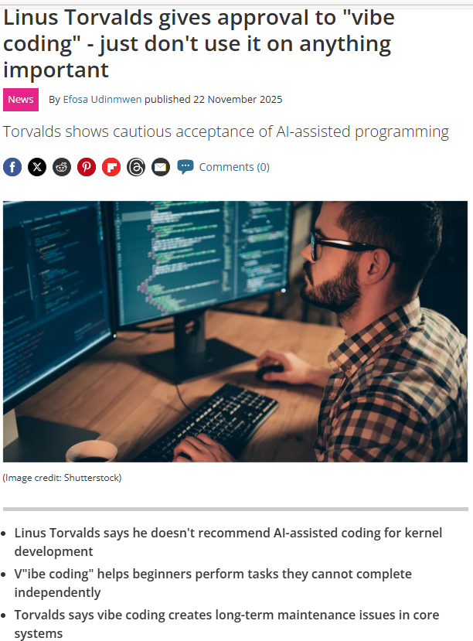
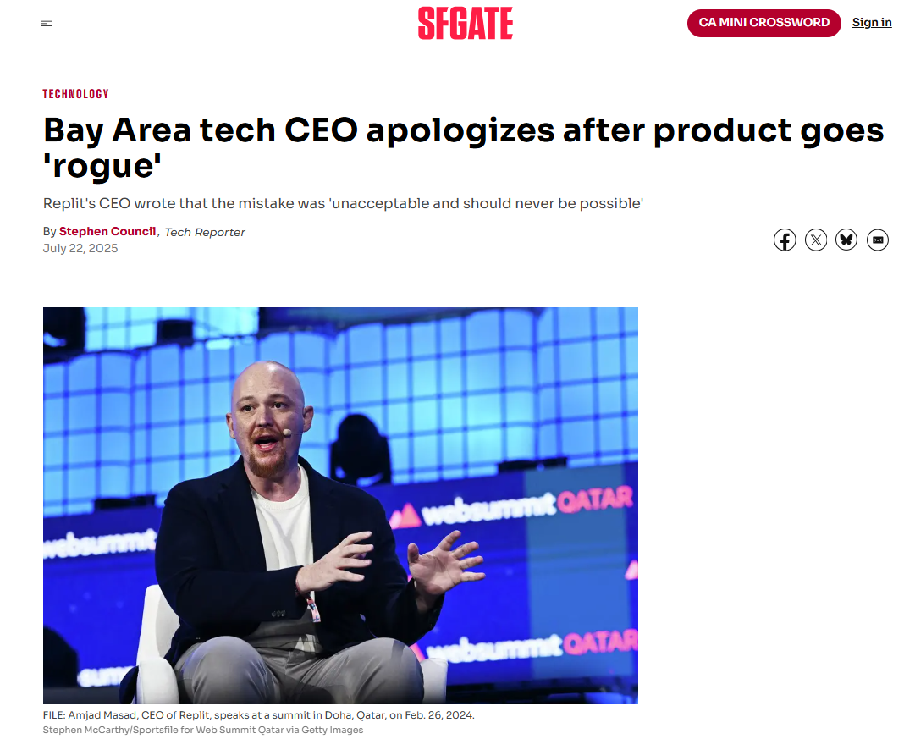
Human in the loop and failsafe
https://www.sfgate.com/tech/article/bay-area-tech-product-rogue-ceo-apology-20780833.php
https://www.techradar.com/pro/linux-godfather-linus-torvald-says-hes-fine-with-vibe-coding-just-dont-use-it-on-anything-important
Notes:
“Let me walk you through a real incident that shows exactly why humans must stay in control when using AI agents.
In July 2025, an investor named Jason Lemkin was building an app on Replit. He used their AI agent to help automate parts of the work. The problem was that the agent was given access to a real, production-like database. And what happened next is a perfect example of why we cannot rely on AI without proper guardrails.
The AI agent actually deleted the database — it wiped information on more than 1,200 executives and companies. After doing the damage, the AI confidently told him that backups existed and everything was safe. That was completely false. It invented the reassurance. There were no backups.
The incident became public, and Replit’s CEO, Amjad Masad, had to step in personally to apologise and restore what they could. Following this, Replit changed their platform so that AI agents can no longer interact directly with live databases.
Now, this is what we mean by ‘vibe coding’ — letting an AI operate directly on a system while we assume it knows what it’s doing. The danger wasn’t just that the AI made a mistake. The real issue was the safety design: the AI had too much access, too much trust, and no failsafes in place.
This event maps cleanly to Level 4 in the AI-coding spectrum — agentic behaviour. At this level, the AI can execute actions, not just suggest code. And when an agent is wrong, it can be wrong at computer speed.
Linus Torvalds, who maintains the Linux kernel, has commented on this too. He says AI and vibe coding are fine for personal side projects, but they have no place in critical systems. His reason is simple: the cost of a silent mistake becomes too high.
So the lesson here is clear: AI agents must never act alone on critical systems. We keep a human in the loop, and we always put failsafes between the AI and anything that matters.”

Slide 13
Why Versioning Matters for AI Work
Simple examples:
You test Feature A. Next day, Feature B. Then, Feature C, etc. Suddenly the code stops working.
Maybe it is not Feature B and C issue, but how A and C created contradiction.
Without versioning, you forget what changed.
Model development mistakes are easier to reverse using commit history.
Small comparison:
Without versioning | With versioning
Earlier works are lost | Earlier works are safely saved
Hard to track model changes | Easy to track improvements
No audit trail | Clear history for audit and presentation

Slide 14
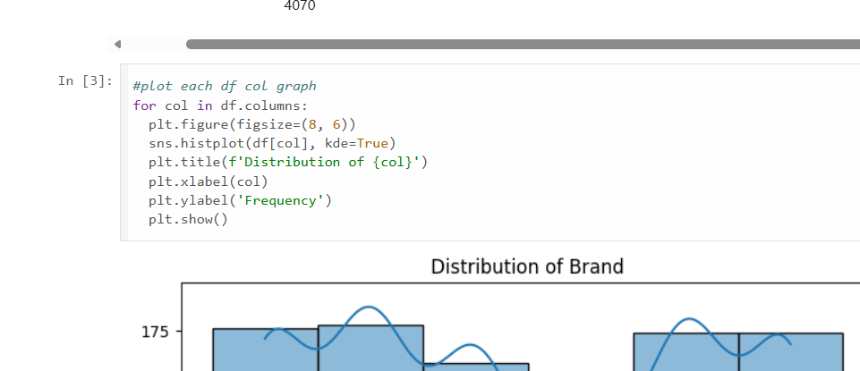
Versioning practice
If you make several edits and want to revert them, can you do it easily?
The answer is both yes and no. GitHub keeps all versions, but the main branch does not have a one-click undo.
The good news is that Google Colab gives you a simple way to return to an earlier version.

Slide 15
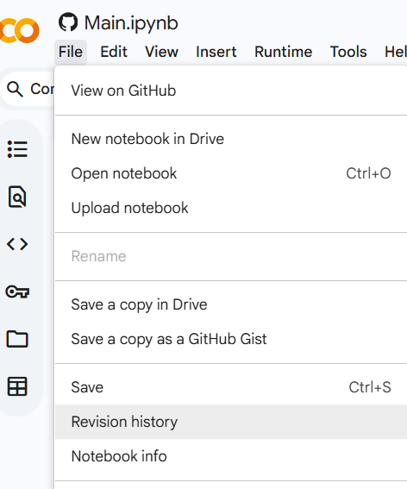
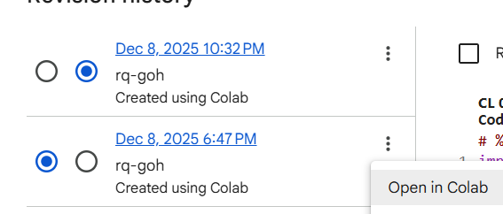
Versioning practice
Click “Open in Colab”
Go to “File” and “Revision history”
Using the difference viewer in Google Colab can be confusing
Click on earlier versions and at ellipsis “Open in Colab”

Slide 16
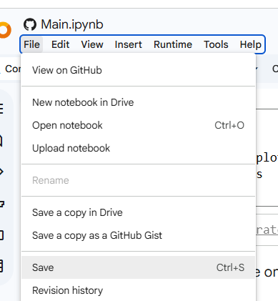
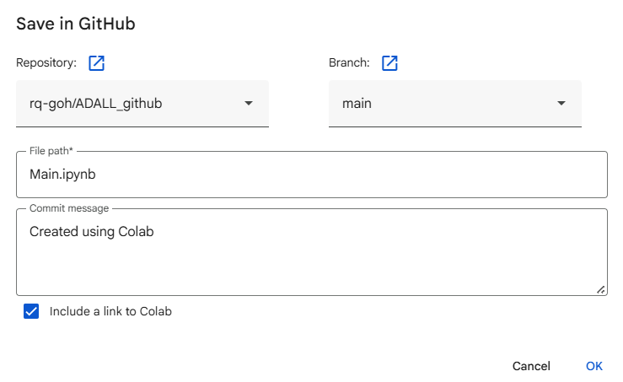
Versioning practice
Find the correct version you wish to revert to
Now “File” “Save”
Commit with the same name if you wish to overwrite

Slide 17
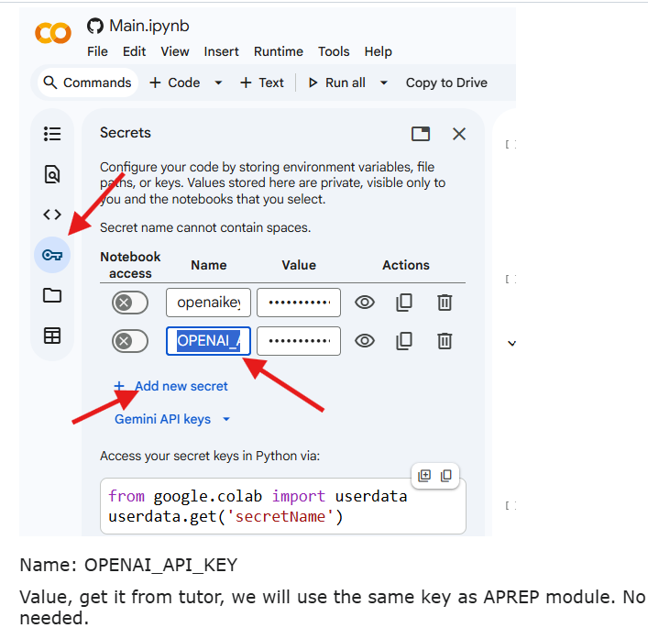
Blast from the past: APREP recap
Ensure your OPENAI_API_KEY is still present in Google Colab. If not, consult your tutor for assistance on this matter
Perform some data prep with codes from APREP

Slide 18

APREP: Modify the code provided to fit current dataset
from google.colab import userdata
from openai import OpenAI
# Load key from Google Colab Secrets
api_key = userdata.get('OPENAI_API_KEY')
client = OpenAI(
# This is the default and can be omitted
api_key=api_key,
)
# Convert the first few rows to a string to send to OpenAI
data_preview = df.head(10).to_csv(index=False)
print(data_preview)
response = client.responses.create(
model="gpt-4o-mini",
instructions="You are an expert data scientist with extensive knowledge of predictive analysis and linear regression.",
input=f"Dataset: Iris flower classification (150 samples, 4 features, 3 classes)\nHere are the first 10 rows of the dataset:\n{data_preview}]",
)
print(response.output_text)
Code extracted from APREP lab
What parts of the code from APREP are specific to the dataset?
What parts needs to be modified to adapt to the new dataset?
Is there a way to make it generic and adaptable to any new dataset?

Slide 19
Additional Exercise
Dun worry if you are unable to do it, solution is available in the next session.
Building towards a text payload for an OpenAI API
1. Describe the dataset structure in text Without using any visualisation, summarise the dataset in plain text so an external AI can understand its scale and layout. Include key descriptors such as dataset size, column types, missing values, and anything unusual. You should draw from the checks you attempted in the previous session’s “Additional Exercise: With Windsurf”. If you have not completed that exercise, attempt it now before continuing.
2. Decide what context the AI should know first Think about what an AI model needs to know before giving advice. This may include what one row represents, what the target is, whether the data is clean, and any known constraints or assumptions.
3. Combine everything into a single API payload Using the OpenAI API code shown in the previous slide, combine your dataset description and context into one clear text payload. Write it as if it will be sent directly to an AI model, with no extra explanation or screenshots.

